Slide 1

Benchmarking: IOHprofiler
Comparing Algorithm Performance

Slide 2

Revision / Context
Over the last few weeks, we have seen multiple different optimization algorithms, each designed based on different principles
Many different ideas and working principles
But, they all fall under a common class: Iterative Optimization Heuristics (IOH)
Natural question: Which algorithm to use in which situation?
So, today we will look at how to compare these different algorithms to each other
{14}

Slide 3
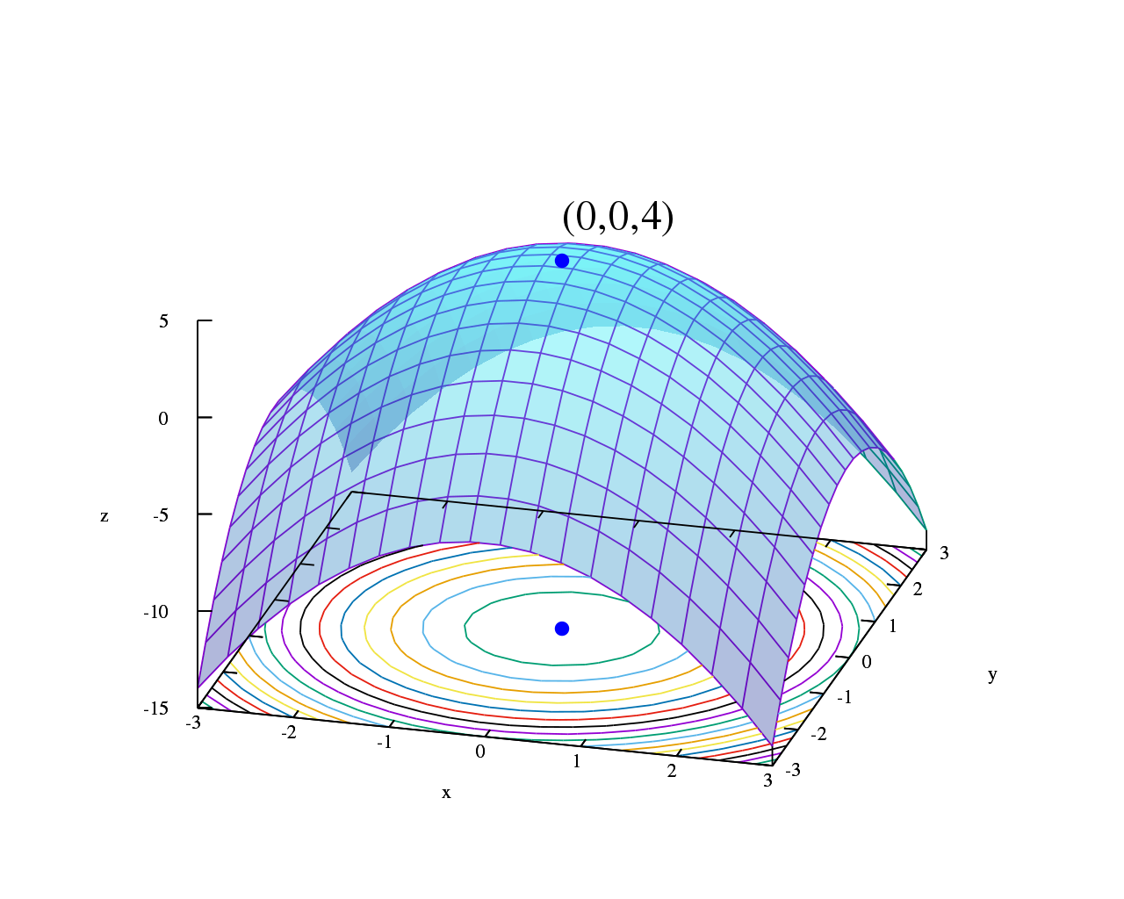
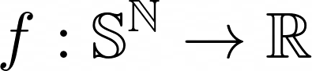
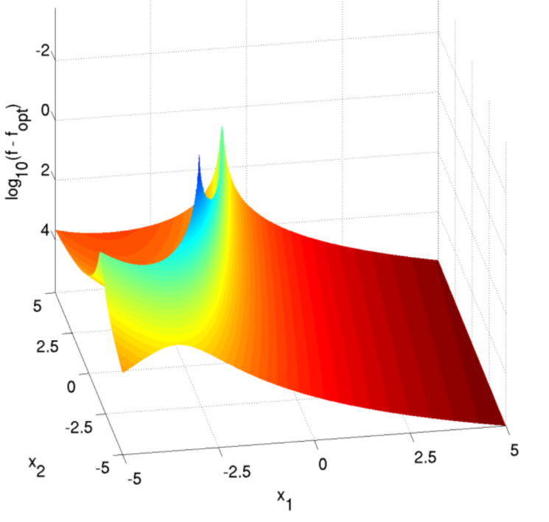
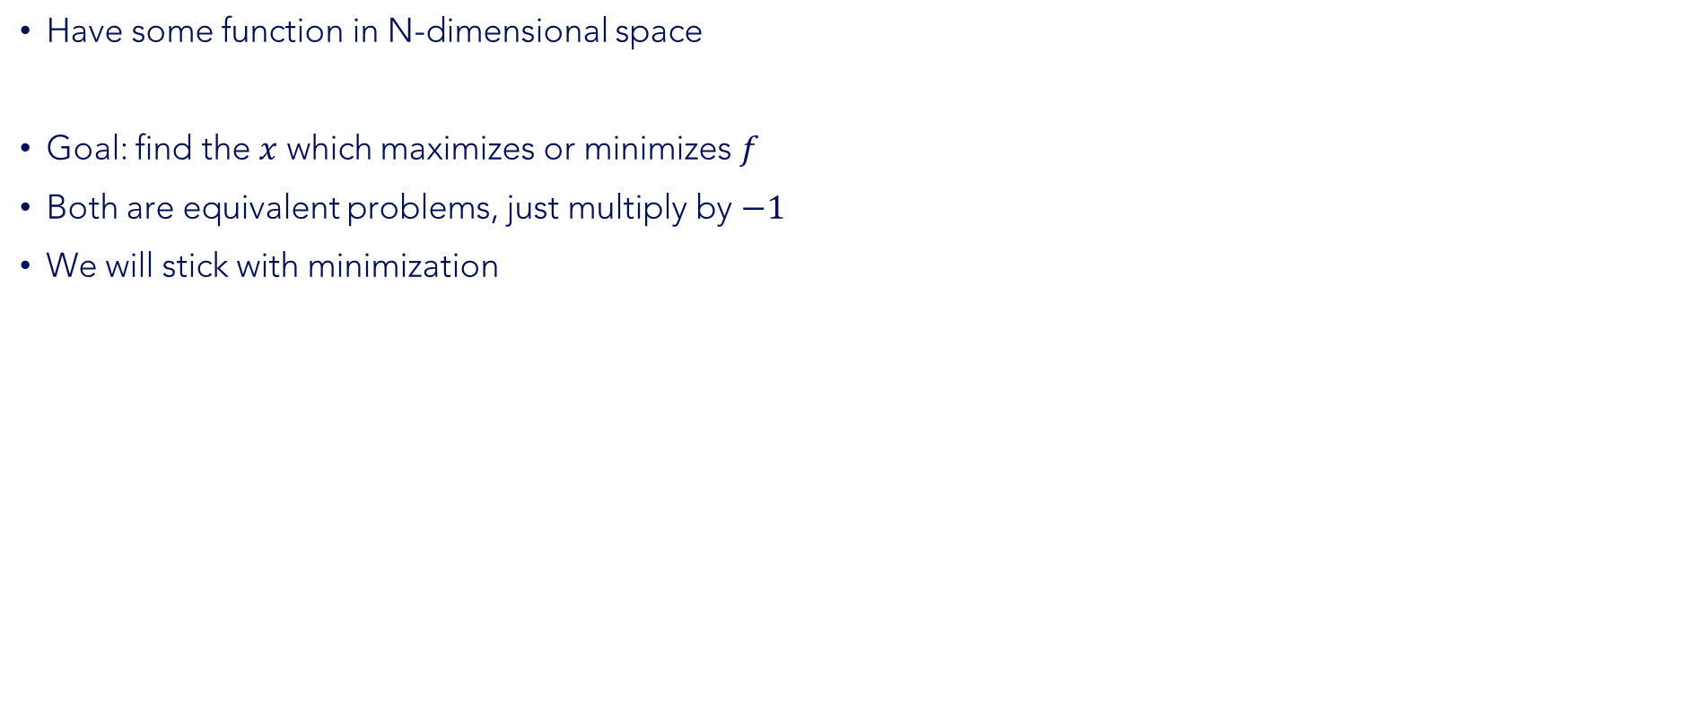
Brief recap of optimization
Have some function in N-dimensional space
Goal: find the $x$ which maximizes or minimizes $f$
Both are equivalent problems, just multiply by $−1$
We will stick with minimization
{1}
{2}

Slide 4


Algorithm Comparison
General question: is an algorithm ‘useful’?
Simpler case: suppose we have two algorithms, A and B
We want to select a single one to use
But how do we know which one is the best?
{3}
{3}
{4}

Slide 5
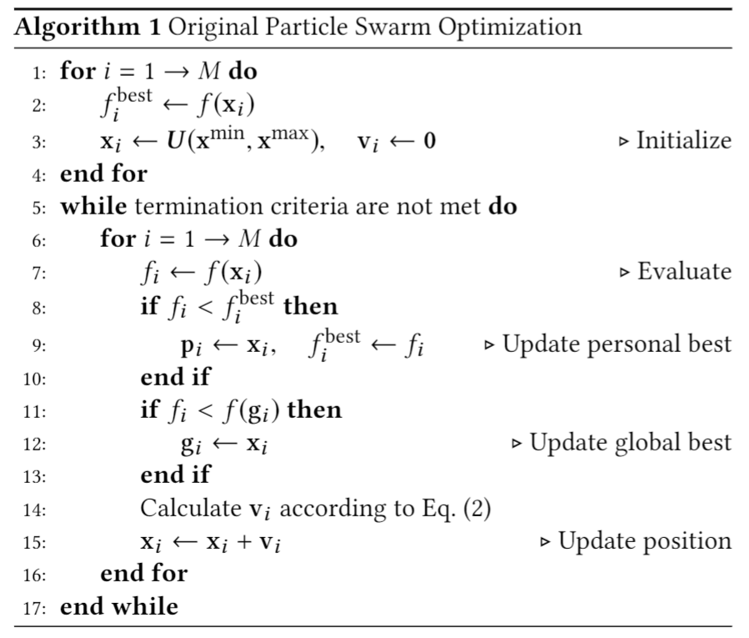
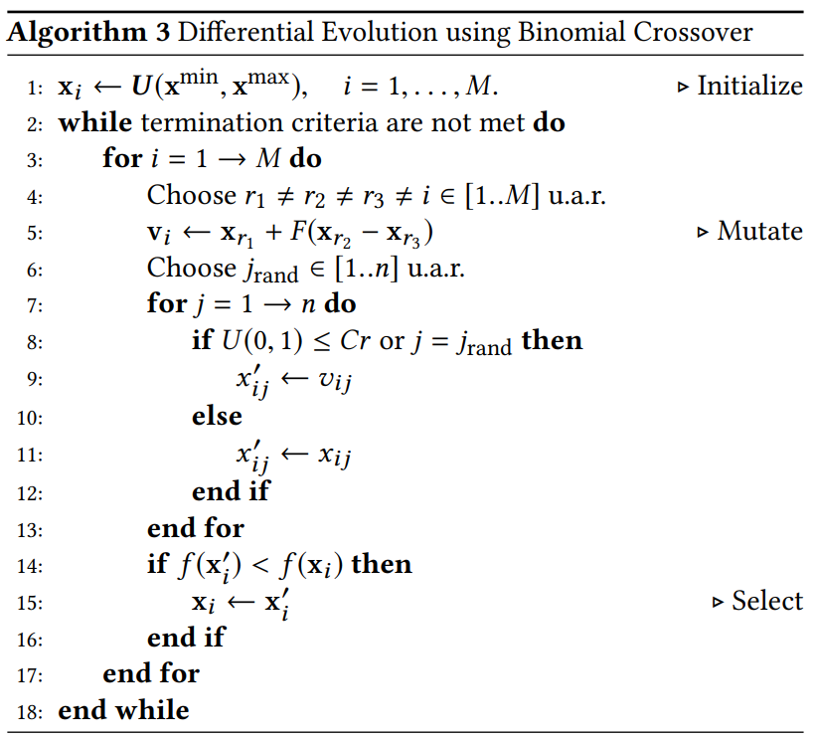
Algorithm Comparison
Option: Investigate algorithm itself (theory)
VS

Slide 6
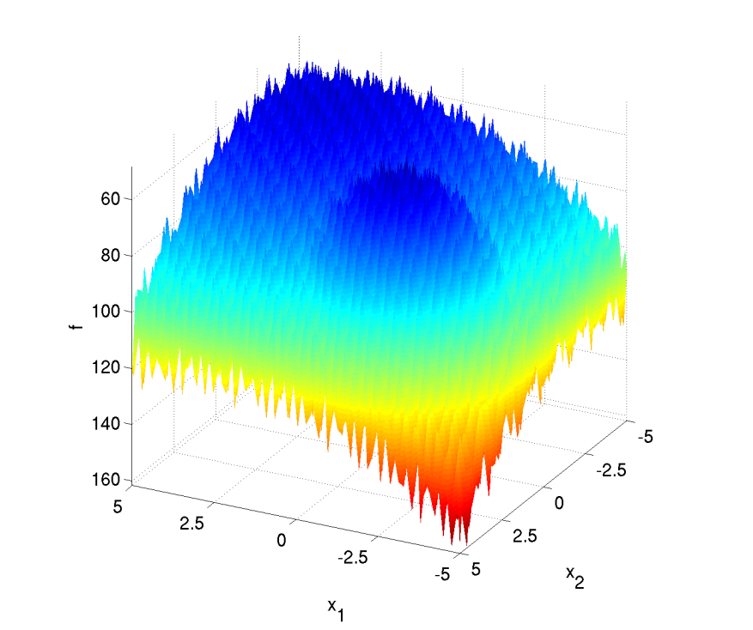
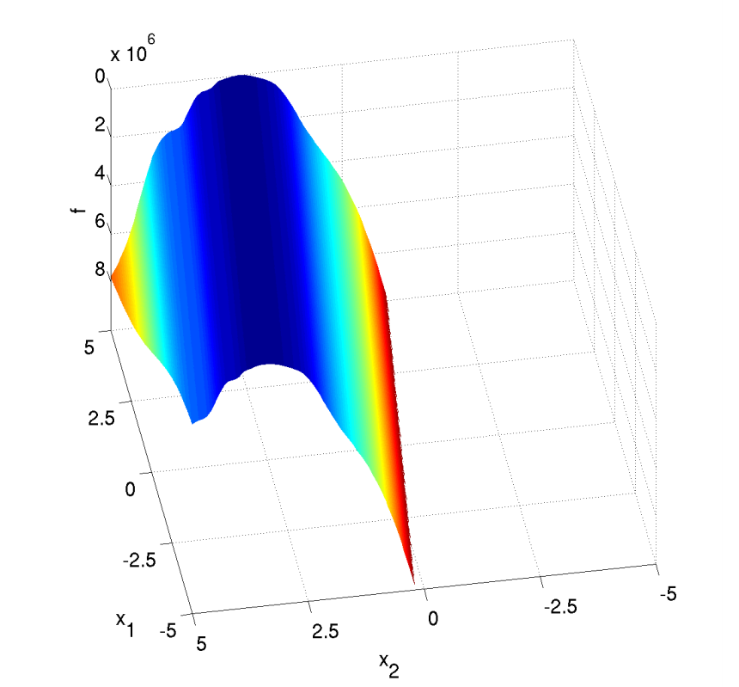

Algorithm Comparison
Important insight: Algorithm comparison is highly function dependent
No Free Lunch: no single algorithm is better then all others on all functions
VS
{2}
{2}
{5}

Slide 7


Algorithm Performance
We know that our algorithm will stop at a certain point
This is either when an optimal solution is found (if we know this)
Or when the algorithm runs out of budget
This leads to two main perspectives:
Fixed-budget: How well does the algorithm perform after a it has evaluated X points?
Fixed-target: How many evaluations does an algorithm need to reach a target value of Y?
{6}
{10}

Slide 8
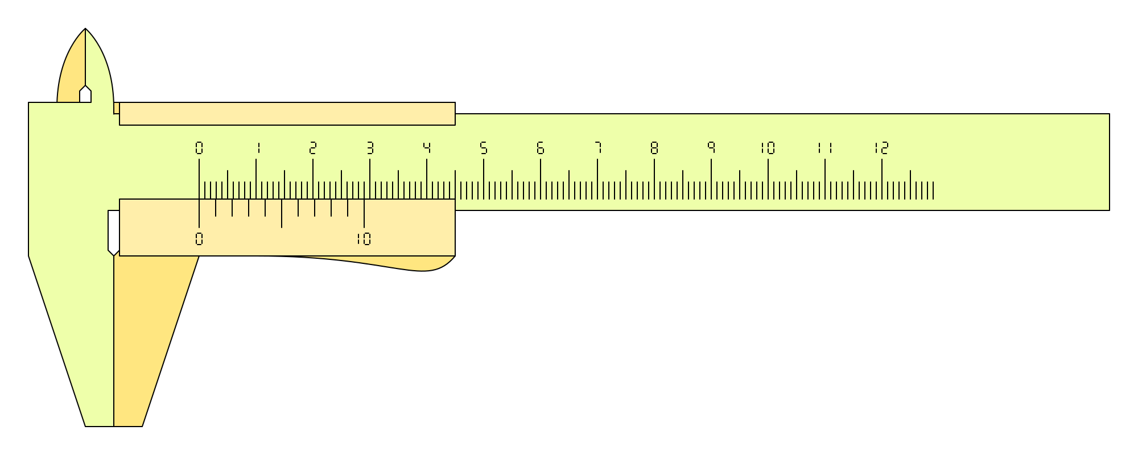
Fixed-Target Performance
In a fixed-target perspective, we need to define targets for the algorithm to reach
Often in terms of difference to the optimum value
Then, we can record when these targets are reached
Need a measure which is independent of hardware or algorithm settings!
So, we don’t base this on time or number of iterations, but on the number of function evaluations
This enables fair comparisons between implementations, runs, settings… !
{7}

Slide 9
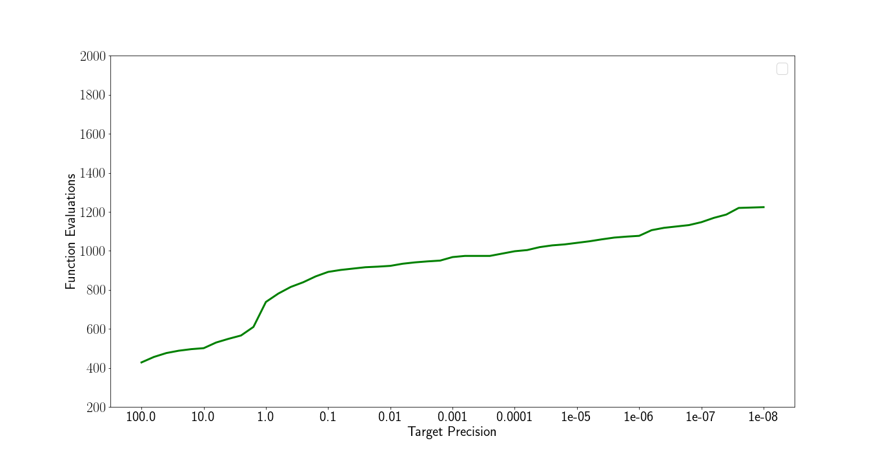
Algorithm Runtime
But, remember that the algorithm is stochastic!

Slide 10
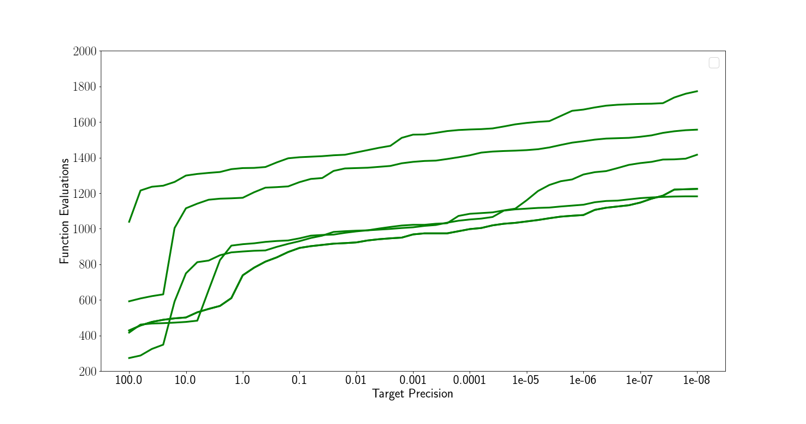
Algorithm Runtime

Slide 11
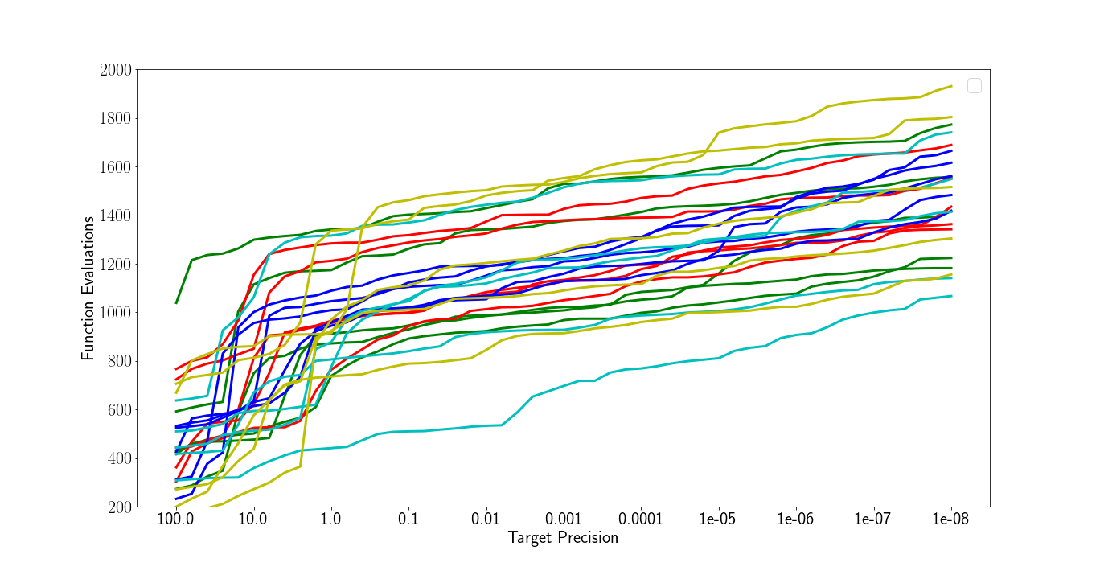
Algorithm Runtime

Slide 12
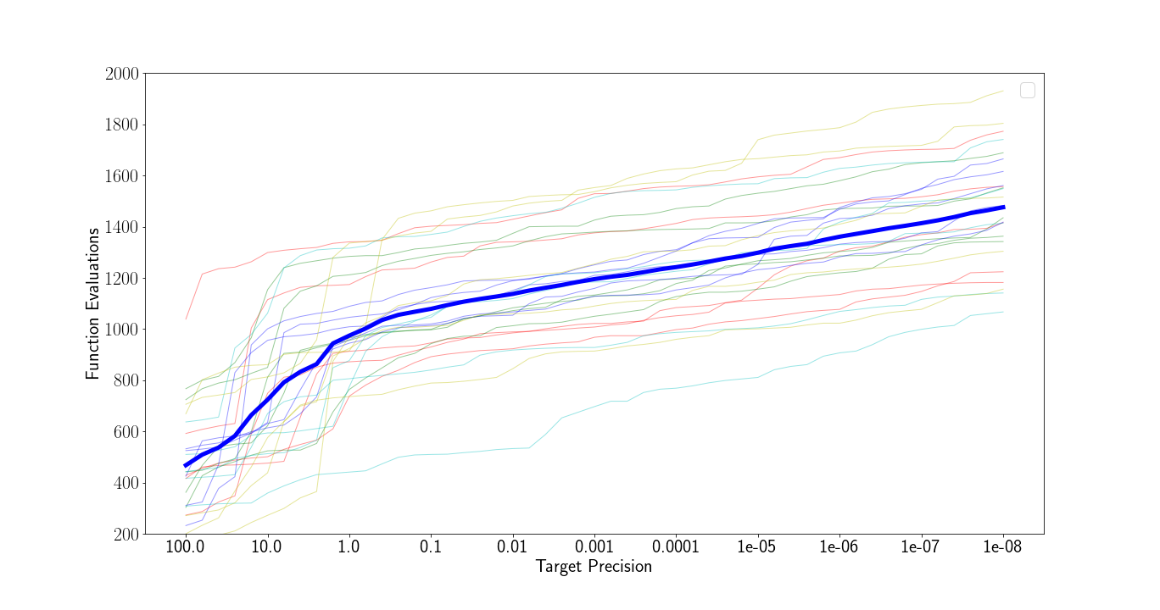
Algorithm Runtime

Slide 13
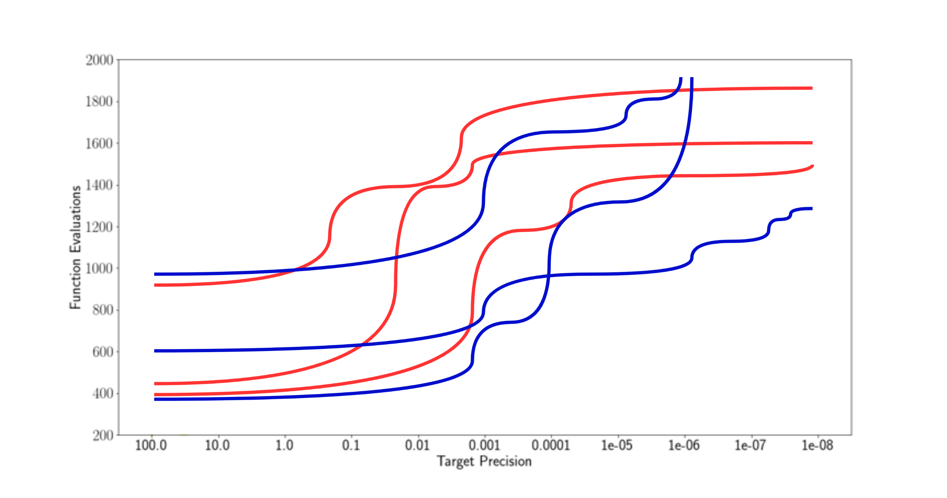
Algorithm Runtime

Slide 14
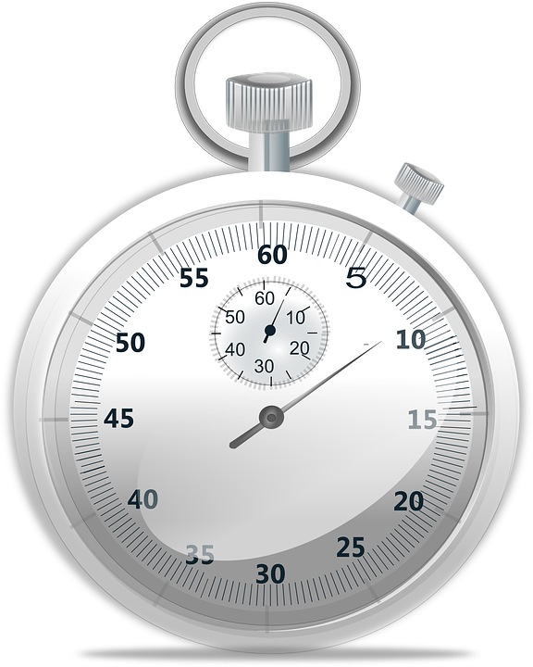
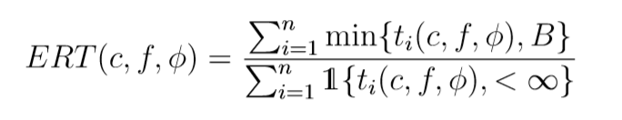
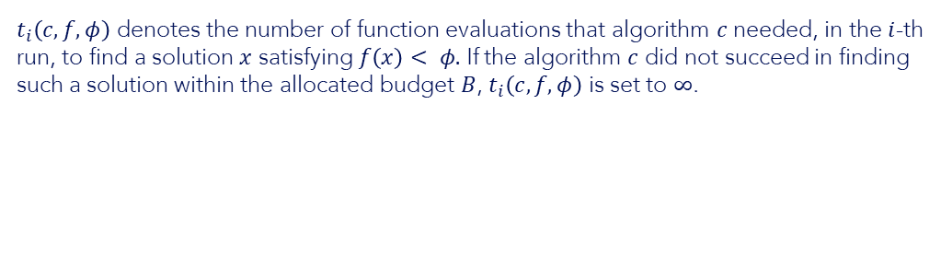
Algorithm Runtime
Just averaging can lead to problems: what to do when a target is not reached?
Instead, we often use Expected Running Time (ERT)
Deals with unfinished runs
Good (fair and unbiased) estimation of mean running time
Very useful when looking for the algorithm to solve a specific problem type the fastest
(1)
{8}
(1)
$t_{i}\left(c,f,φ\right)$ denotes the number of function evaluations that algorithm $c$ needed, in the $i$-th run, to find a solution $x$ satisfying $f\left(x\right)< φ.$ If the algorithm $c$ did not succeed in finding such a solution within the allocated budget $B$, $t_{i}\left(c,f,φ\right)$ is set to $∞$.

Slide 15
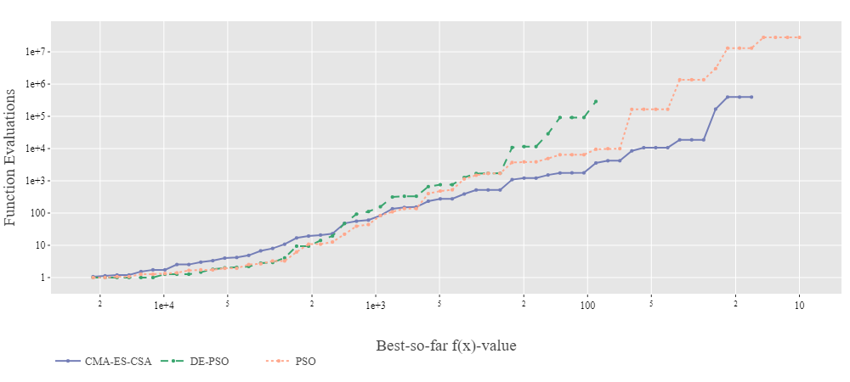
Study case: Fixed-target result
Goal: Find the algorithm using the least function evaluations to find the target.

Slide 16

Flipping Perspectives: Fixed-Budget
Sometimes, we are more interested in performance within a certain budget
Budget is defined in terms of function evaluations, to ensure fair comparisons!
Interested in best-so-far function value after x evaluations
Aggregate using descriptive statistics: mean, median, quantiles…
{9}

Slide 17
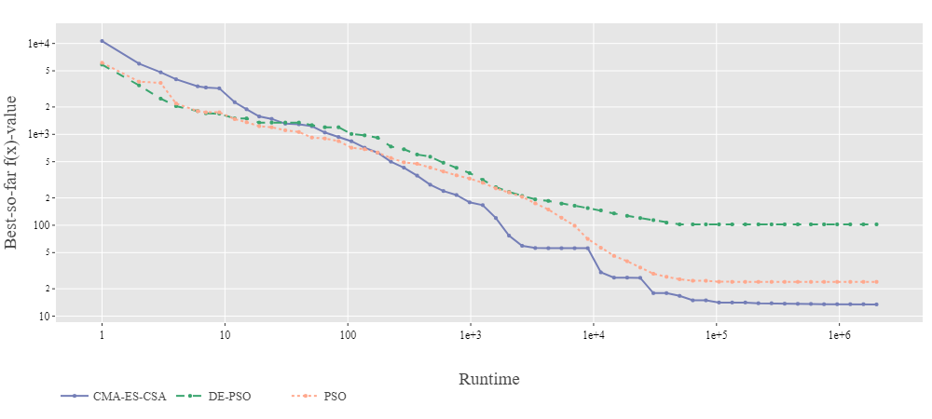
Study case: Fixed-budget result
Goal: Find the algorithm hitting the best target within the fixed budget.

Slide 18
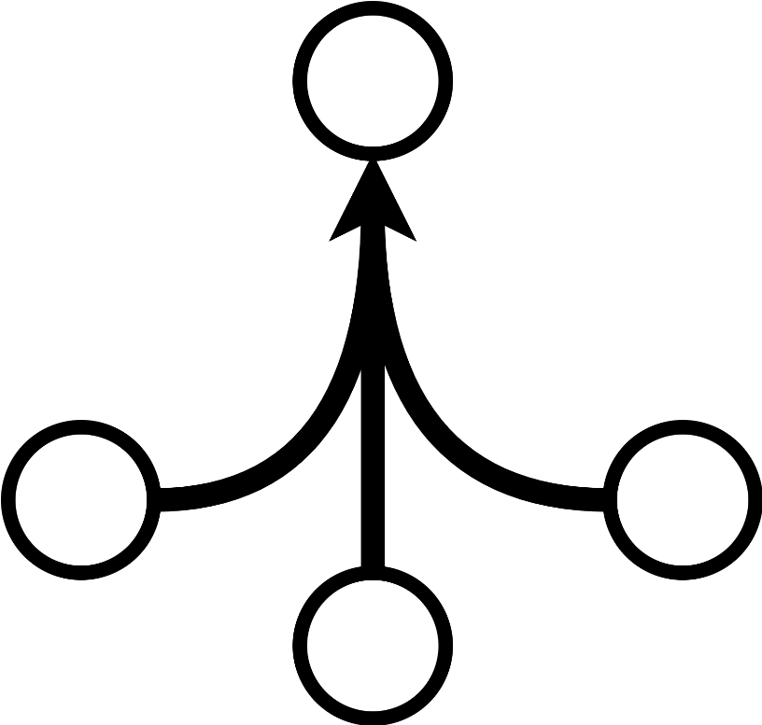
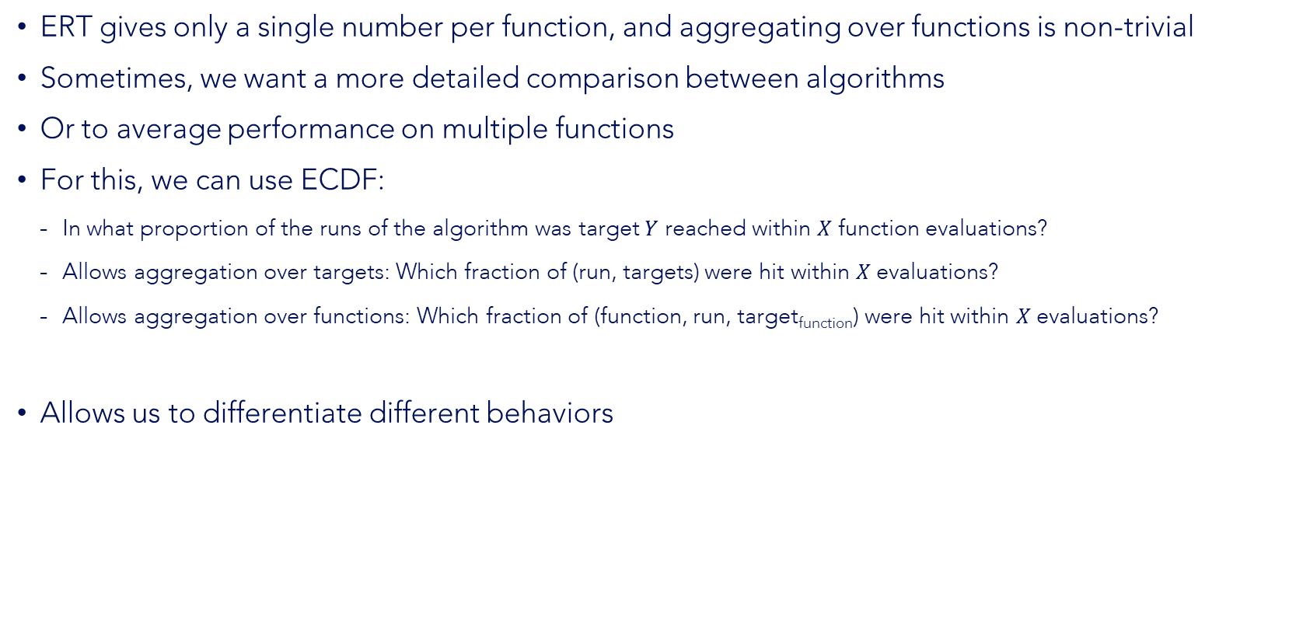
Empirical Cumulative Distribution Function
ERT gives only a single number per function, and aggregating over functions is non-trivial
Sometimes, we want a more detailed comparison between algorithms
Or to average performance on multiple functions
For this, we can use ECDF:
In what proportion of the runs of the algorithm was target $Y$ reached within $X$ function evaluations?
Allows aggregation over targets: Which fraction of (run, targets) were hit within $X$ evaluations?
Allows aggregation over functions: Which fraction of (function, run, target_{function}) were hit within $X$ evaluations?
Allows us to differentiate different behaviors

Slide 19
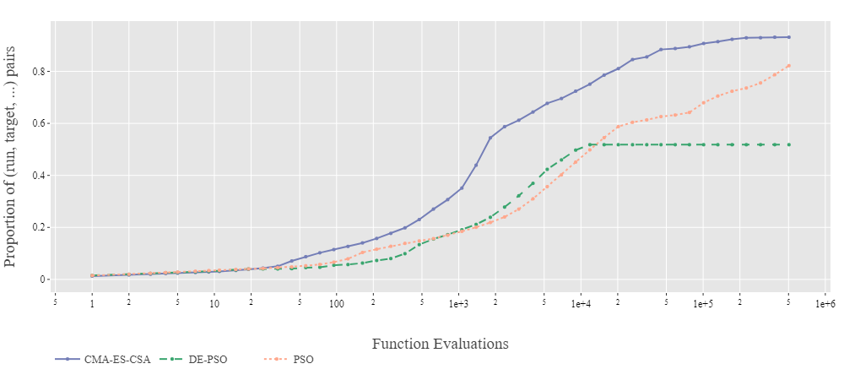
ECDF: Example

Slide 20

IOHprofiler
A modern and effective tool for benchmarking and analyzing iterative optimization heuristics (IOHs)
Standardized experimental environment
Interactive performance analyses and statistics
Public, cloud-based data repositories for
Solvers
Benchmark problems
Performance data
{13}

Slide 21
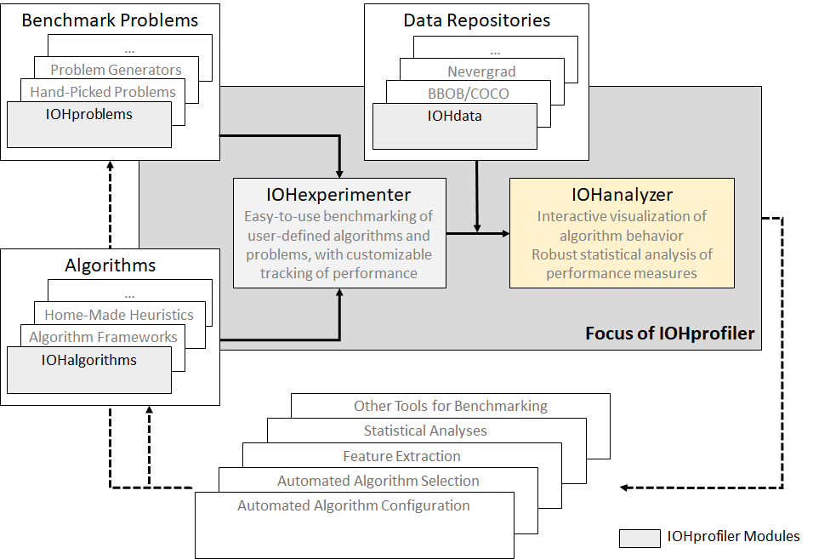
IOHprofiler

Slide 22


IOHexperimenter
Easy environment to create algorithms
Pre-defined benchmark functions available
Will be used during the assignment
Available in C++, R and python
{12}
{11}

Slide 23
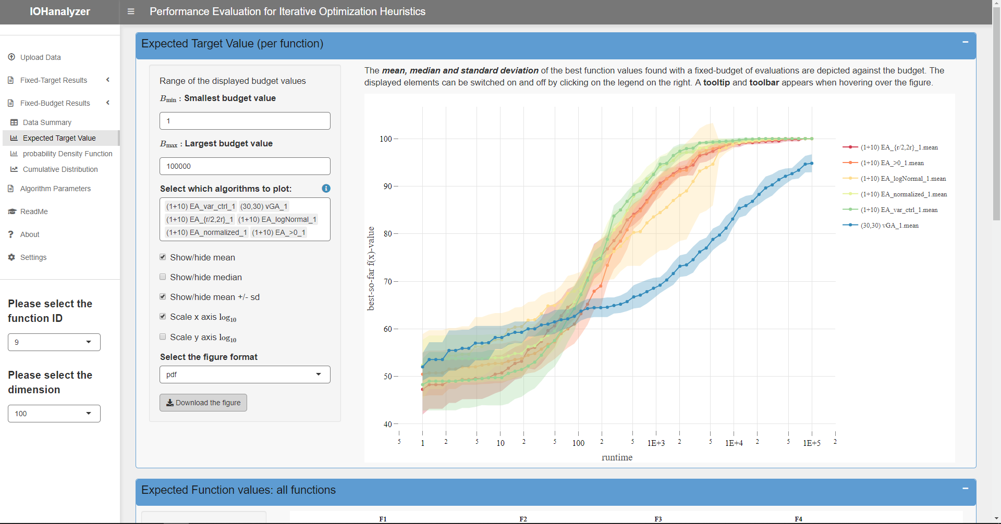
IOHanalyzer
Data analysis and visualization
Easy to use with data from IOHexperimenter
Interactive plots for easy data exploration
Available at:
http://iohprofiler.liacs.nl
https://github.com/IOHprofiler/IOHanalyzer

Slide 24

DEMO
The video demonstrating how to use the IOHprofiler is available separately (on brightspace)

Slide 25
Questions? email them to NACO-TA@liacs.leidenuniv.nl or post them in Brightspace

Slide 26
Figure Sources
{1} https://en.wikipedia.org/wiki/Mathematical_optimization
{2} https://coco.gforge.inria.fr/downloads/download16.00/bbobdocfunctions.pdf
{3} https://pixabay.com/illustrations/bench-press-fight-arm-wrestling-1013857/
{4} https://pixabay.com/illustrations/balance-swing-equality-measurement-2108024/
{5} https://pixabay.com/vectors/no-food-no-eating-food-ban-154333/
{6} https://pixabay.com/illustrations/checklist-clipboard-questionnaire-1622517/
{7} https://es.wikipedia.org/wiki/Calibre_(instrumento)
{8} https://pixabay.com/vectors/stopwatch-racing-timer-timing-153398/
{9} https://pixabay.com/photos/crystal-ball-magic-mystical-1907339/
{10} https://pixabay.com/photos/run-treadmill-silhouette-sport-fit-4181899/
{11} https://pixabay.com/vectors/flat-design-symbol-icon-www-2442462/
{12} https://pixabay.com/vectors/bubble-chemical-chemistry-glass-2022490/
{13} https://pixabay.com/vectors/target-arrow-bulls-eye-bullseye-2070972/
{14} https://pixabay.com/photos/lightbulb-concept-cork-bulletin-2692247/

